Slide 1


“Laying the foundation and structure to your future”
by Coral S. Schmidt Montilla, Jaime J. Cuebas Ruiz, Christopher Ortiz, Christian Brito & Taishali N. Jimenez Quiñones

Slide 2


Introduction
Members | About Us | Roles
Coral S. Schmidt Montilla | Mayor: Computer Science Future: Earn certifications & applying for jobs. | Front-end, Back-end, Business Analyst/System Analyst & Project Manager.
Taishali N. Jiménez Quiñones | Mayor: Computer Engineering Future: Driven to pursue a career, with a focus on building impactful applications and developing skills through hands-on experience. | Project Manager, Frond-end, Back-end & Business Analyst/System Analyst

Slide 3


Introduction
 | About Us | Roles
Jaime J. Cuebas Ruiz | Mayor: Computer Engineering Future: Applying for jobs & creating a portfolio for future partnerships. | Front-end & Back-end
Christopher Ortiz | Mayor: Computer Science Future: Continue on becoming a Full-Stack Flutter developer and deliver industry standard applications. | Front-end
Christian Brito | Mayor: Computer Science Future: Continue working in the IT field, Studying for certifications and Looking for new Job opportunity | Quality manager & Front-end

Slide 4
What we will be covering
Problem
Solution
What is our product?
Competition
Why we chose Outsystems
Project demo
User Interface
Database
Software & tools
Notes:
Problem:
Today we will be covering all of the overall structure and implementation of our Resume Builder App and the problem that we want to solve.
Solution:
The solution we established that we believe best suits the overarching problem at hand.
What is our product?
We will cover the overview of what our product is, solves and represents towards solving our problem.
Competition:
How our product compares against the competition and why we believe ours provides the best solution.
Why We Chose Out Systems:
We will also cover on the topic on why we chose the Out Systems framework as our main development platform.
Software & Tools:
All of the Software, Tools and Programming principles that we also used.
Project Demo:
We will then show a live demonstration of how our product works and functions.
User Interface:
We will then describe in detail the user interface and the logic behind our user experience flowcharts.
Database:
Finally, we will cover how our product's database plays a key role on the overall functionality of our Resume Builder.

Slide 5


Problem
Market gap
Many job seekers struggle to create professional resumes, and existing tools are often outdated, complex, or costly.
Customers
Job seekers and interns need a free and easy-to-use resume builder to improve their chances in an increasingly competitive market​.
Financials
The demand for recruitment technology is rising, with companies investing heavily in hiring and resume-screening solutions [HiringThing].
Costs
Most resume-building platforms charge a fee or limit free access, while our solution aims to remain free through a university partnership​.
Usability
Users need a simple, intuitive solution that ensures their resumes are customizable, professional, and ATS-compliant​.
Notes:
Job seekers face multiple challenges in creating professional resumes, and existing solutions fall short in key areas.
- Many resume tools are outdated, complex, or expensive, making it hard for job seekers to stand out.
Interns and job seekers need a free, easy-to-use tool to improve their chances in a competitive market.
Companies are investing more in recruitment tech, showing the demand for better resume solutions.
Most resume builders charge a fee or limit access, while our solution remains free through a university partnership.
Users need a simple, intuitive, and ATS-compliant solution to ensure their resumes get noticed.

Slide 6
Resume Statistics
Notes:
This slide presents key statistics on the challenges job seekers face in the resume screening and hiring process.
We have two types of data here: percentage-based insights on the left and count-based metrics on the right.
Percentage Data
- A significant percentage of resumes fail to pass ATS (Applicant Tracking Systems), which shows the importance of optimizing resumes with the right keywords.
- Over 80% of employers use ATS, meaning applicants must tailor their resumes to be machine-readable.
- Many resumes fall outside the ideal word range, which could impact their effectiveness.
- Very few resumes actually reach hiring managers, reinforcing the importance of crafting an optimized resume.
Count Data
The ideal resume length is typically between 600-700 words, showing that brevity and conciseness matter.
On average, recruiters spend only a few seconds reviewing resumes, emphasizing the need for clear formatting and keyword optimization.
Each job posting receives hundreds of applications, highlighting the intense competition job seekers face.
These statistics justify why we need a smart resume builder; to help job seekers optimize their resumes for ATS, improve keyword usage, and increase their chances of getting noticed.

Slide 7

What Is Our Product?
Easy-to-use app for building professional resumes
Step-by-step guidance to help users fill out each section
Job-specific recommendations based on industry needs
Customizable templates for a polished, professional look
Cloud storage & instant downloads for easy access anytime
Designed for students, job seekers, and professionals
Notes:
Our product is a user-friendly app designed to help job seekers create professional, tailored resumes quickly and efficiently.
No design skills needed! Our intuitive app makes resume building effortless.
We walk users through each section to ensure they include all the right details.
The app provides job-specific suggestions based on industry needs, helping users stand out.
Choose from professionally designed, ATS-friendly templates for a polished look.
Save, edit, and download resumes anytime, from any device.
Perfect for students, job seekers, and professionals who need a competitive edge.
With smart guidance, industry insights, and customizable features, our product ensures users create the best possible resume to land their dream job.

Slide 8
Solution
Close the gap
Our product makes managing tasks easier, and no other product on the market offers the same benefits.
Cost savings
Reduce costs for client by helping project managers stay on target within deadlines.
Target audience
Job seekers, students, and interns who need professional, customizable resumes without struggling with outdated or costly alternatives​.
Easy to use
A guided, step-by-step interface with pre-designed templates, smart suggestions, and real-time resume feedback, ensuring a seamless and efficient user experience​.
Cloud Storage & Accessibility
Users can save, edit, and download their resumes from any device​.
Security & Reliability
Secure authentication and cloud-based backups ensure data safety and easy retrieval.​
API Integration
Pulls job-specific recommendations to tailor resumes based on industry trends​.
Notes:
Here is our solution.
Our resume builder bridges the gap by providing an efficient, accessible, and secure solution for job seekers.
Close the gap
- Unlike other tools, we provide a streamlined process that ensures every user gets professional, optimized resumes.
Cost savings
Eliminates costly services with a free, user-friendly platform.
Target audience
Ideal for job seekers, students, and interns needing professional resumes.
Easy to use
Guided templates, smart suggestions, and real-time feedback make resume creation effortless.
Cloud Storage & accessibility
Save, edit, and download resumes from any device anytime.
Security & reliability
Secure authentication and cloud backups protect user data.
API integration
Pulls real-time job recommendations for tailored resumes
Our platform is fast, cost-effective, and optimized for success, giving job seekers a real edge in today’s competitive market.

Slide 9
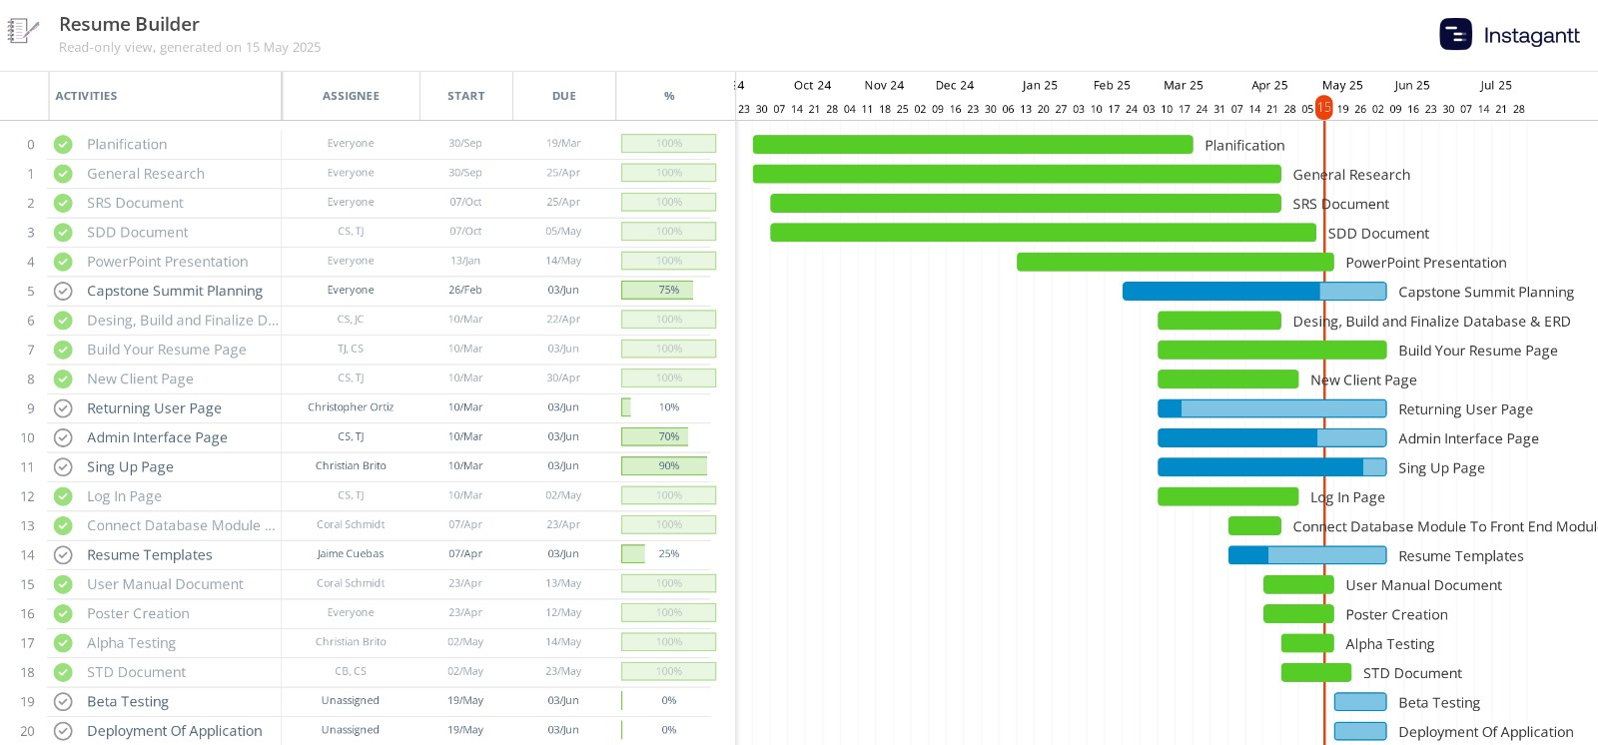
Project schedule
Notes:
Taishali and I started brainstorming this idea during our final project for our Software Engineering class.
It’s fulfilling to see how something we first sketched on paper evolved into a working system.
This Gantt chart represents not just a timeline, but all the hard work, collaboration, and commitment our team poured into every task of the Resume Builder.
21 tasks
174
145
Longest General Research
Shortest Alpha Testing
We’re especially thankful to Jaime, Christian, and Cristofer for helping us turn this idea into a reality. Whether it was coding, documentation, or testing, everyone played a key role.

Slide 10



Our competition
ResumeGenius
Strengths: Allows flexible resume design with drag-and-drop customization.
Resume.com
Strengths: Free and allows users to store past resumes.
Canva
Weaknesses: Lacks ATS optimization, meaning resumes may get rejected by hiring software.
Our Advantage: We provide both customization and ATS-friendly formatting.
Strengths: Provide structured resume-building guidance and template customization.
Weaknesses: Charge users upon completion, restricting access unless they pay.
Our Advantage: We offer the same structured guidance without hidden fees.
Weaknesses: Lacks guided resume-building and customized job recommendations.
Our Advantage: We offer a free service with easy understandable suggestions and industry-specific recommendations.
Notes:
To understand how our resume builder stands out, let’s look at the strengths and weaknesses of our competitors.
ResumeGenius
Strengths: They provide structured resume-building guidance and pre-designed templates.
Weaknesses: They charge users upon completion, making it difficult for job seekers who need a free option.
Our Advantage: We offer the same structured guidance without hidden fees.
Canva
Strengths: It allows drag-and-drop customization, making resume design flexible and visually appealing.
Weaknesses: However, it lacks ATS (applicant tracking system) optimization, meaning resumes may get filtered out by hiring software.
Our Advantage: We combine customization with ATS-friendly formatting, ensuring resumes pass screening systems.
Resume.com
Strengths: It is free and allows users to store past resumes for easy access.
Weaknesses: However, it lacks guided resume-building and customized job recommendations.
Our Advantage: We offer AI-driven suggestions and industry-specific recommendations, helping users create tailored resumes.

Slide 11

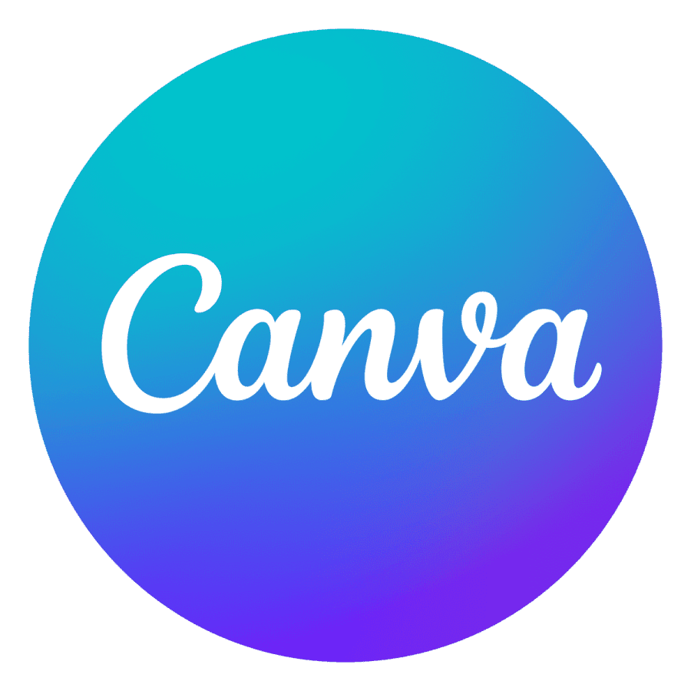

Competition
Convenient
Expensive
Affordable
Inconvenient
Notes:
This chart compares resume-building tools based on cost (expensive vs. affordable) and ease of use (convenient vs. inconvenient).
(Top Left)
- ResumeGenius – Offer guided resume creation but charge users to download.
(Bottom Left)
- Great for design, but not ATS-friendly and requires manual formatting.
(Bottom Right)
- Resume.com & Microsoft Word – Free options but lack structured guidance and ATS optimization.
(Top Right)
- Our platform is affordable, AI-driven, and easy to use; combining the best of all competitors without hidden fees.

Slide 12
Why we stand out
Combines the best of all competitors
Structured guidance like ResumeGenius, flexibility like Canva, and free access like Resume.com.
No payment barriers
Unlike ResumeGenius, our users never have to pay to download their resumes.
AI-powered customization
Unlike Canva, our resumes are optimized for ATS, ensuring better job application results.
Seamless user experience
Unlike Resume.com, our builder guides users with smart suggestions to maximize resume quality.
Notes:
Unlike our competitors, our resume builder combines the best features of all of them while eliminating their biggest drawbacks.
We offer the structured guidance of ResumeGenius, the flexibility of Canva, and the free access of Resume.com; all in one platform.
Unlike ResumeGenius, we never charge users to download or access their resumes—our tool remains completely free and accessible.
Unlike Canva, our resumes are ATS-optimized, ensuring they pass through hiring software filters and improve job application success.
Unlike Resume.com, we provide smartguidance to help users refine their resumes, making them more effective and tailored.
Our platform is not just another resume builder; it is a smarter, more accessible, and optimized tool that gives users the best chance at landing a job.

Slide 13
Why we chose OutSystems?
Integration Power: Seamlessly connects with databases, APIs, and services.
Cross-Platform Compatibility
Security & Maintainability: Built-in architecture governance and security checks.
Enterprise-Grade Protection
Role-Based Access Control (RBAC)
AI-Driven Security
Automated Maintenance
Enterprise-Grade Apps: Supports scalable, cloud-native applications.
Scalability
Auto-Scaling
Serverless Efficiency
Multi-Cloud & On-Prem​.
Develop applications 7x faster with reusable components.
Eliminate Repetitive Coding
Visual Development
Drag-and-Drop Logic
The industry recognizes OutSystems as a top-tier development platform.
Trust & Reliable
OWASP Compliance
Full Security Visibility
Rapid Deployment
Strong Community Support
Continuous Innovation
API Integration
Direct Database Access
Custom Connectors
Notes:
Here are the key reasons we chose OutSystems, focusing on its integration capabilities, security, scalability, speed of development, and industry recognition as a top-tier development platform.
🔗
Integration Capabilities
OutSystems offers robust integration tools that make it easy to connect with third-party APIs, legacy systems, and external databases—all without the complexity of traditional middleware.
Modern applications need to function in interconnected environments. Whether it’s integrating with payment gateways, authentication services, or backend systems, OutSystems allows us to build an app that’s both flexible and future-ready.
🔒
Security and Code Maintainability
OutSystems follows industry best practices for security, including built-in protections against common vulnerabilities like SQL injection It also generates clean, maintainable code behind the scenes.
Especially in enterprise or sensitive environments, security is non-negotiable. OutSystems ensures our application meets compliance needs while making it easier to update and scale in the future without introducing instability.
📈
Scalability
Unlike many low-code platforms, OutSystems is designed to scale—both in terms of user load and complexity. It supports horizontal and vertical scaling, with cloud-native architecture.
Many low-code solutions are great for small apps but struggle under heavy traffic or complex logic. With OutSystems, we can confidently build a solution that’s ready for real-world usage and potential business growth.
⚡
Speed of Development
OutSystems dramatically speeds up development with visual workflows, reusable components, and automation tools, allowing us to focus more on solving user problems than writing useless code.
Time was a critical factor in our Capstone project. OutSystems enabled us to deliver a fully functional and polished app within a tight academic timeline, without compromising on quality or features.
🏆
Industry Recognition & Support
OutSystems is consistently recognized by analysts like Gartner and Forrester as a leader in the low-code space. It also has an active developer community and extensive documentation.
Choosing a trusted platform reduces the risk of running into roadblocks. With access to a wealth of resources, tutorials, and community forums, we were able to troubleshoot issues efficiently and ensure we were building on a reliable, well-supported foundation.

Slide 14







Software & tools
Outsystems
Java Script
Python
HTML5
CSS3
C-Sharp
Microsoft Word
Notes:
In this project, OutSystems was used as the primary platform to visually design and build the resume builder application using it's reactive web framework.
JavaScript was integrated to handle the conversion of the final resume into a downloadable PDF format.
Python supported the development process by assisting in the creation of dynamic resume templates.
HTML was used to customize the structure of the interface and CSS was used to create the folders animation for a clean, user-friendly experience.
And although C# was not directly used in the development process, it underpins OutSystems' server-side logic, ensuring smooth execution of business processes.

Slide 15
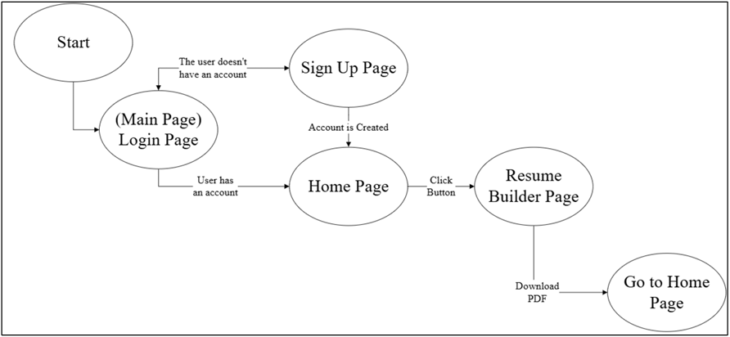
User Interfaces
Resume Builder State Diagram
Notes:
This diagram shows how users navigate through our resume builder app.
Login or Sign-Up: Users start at the login page and create an account if needed.
Home Page: The main hub where users can access different features.
Resume Builder: Users create and edit resumes, then download a PDF.
Seamless Navigation: After downloading, they can return to the home page for further actions.
Our design ensures a simple and intuitive user experience.

Slide 16
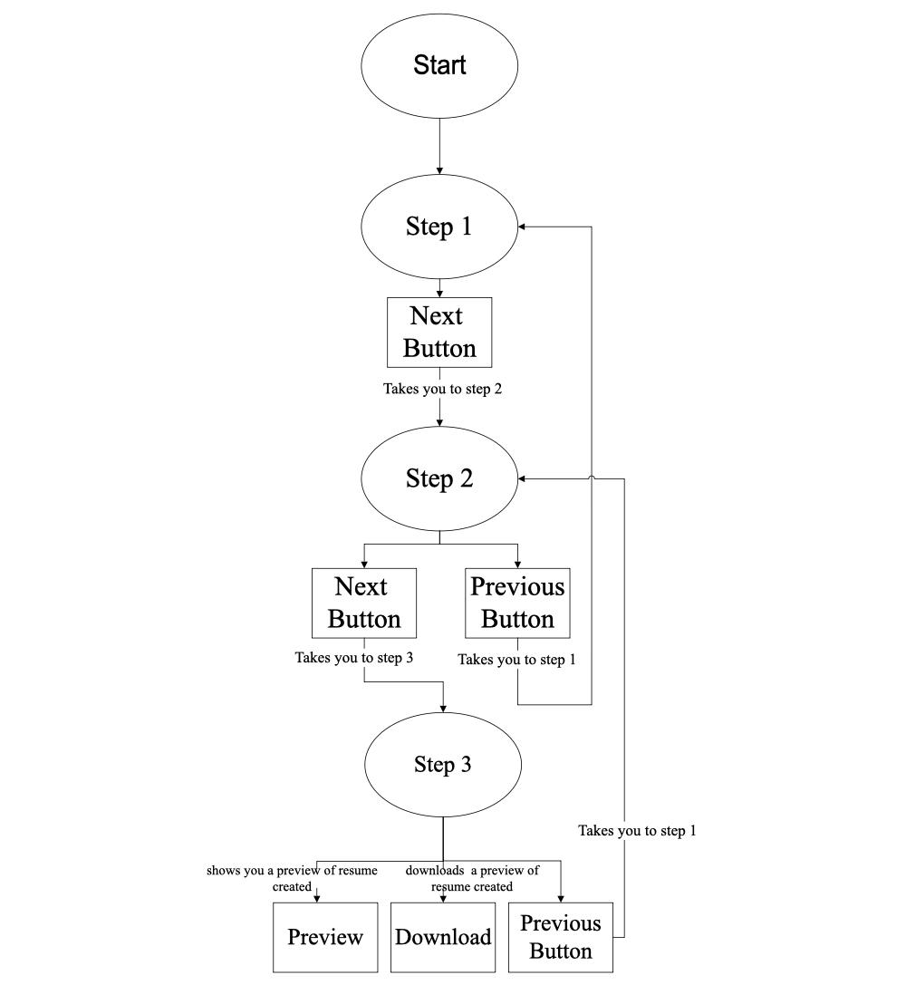
User Interface
Resume Builder Steps State Diagram

Slide 17
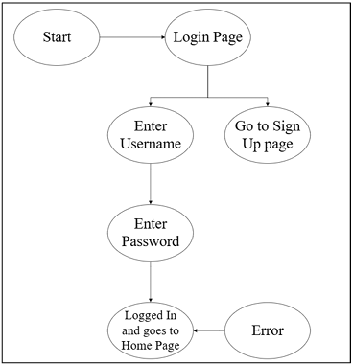
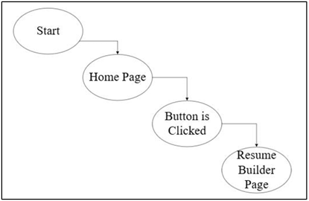
User Interfaces
Home Page State Diagram
Main Page State Diagram
Notes:
These diagrams show the navigation flow within our app.
Home Page Flow: Users start at the Home Page and can click a button to access the Resume Builder Page.
Login Flow: Users enter their username and password to log in.
If credentials are correct, they go to the Home Page; if incorrect, they see an error message.
New users can sign up from the login page if they don’t have an account.
This structure ensures a smooth and intuitive user experience.

Slide 18
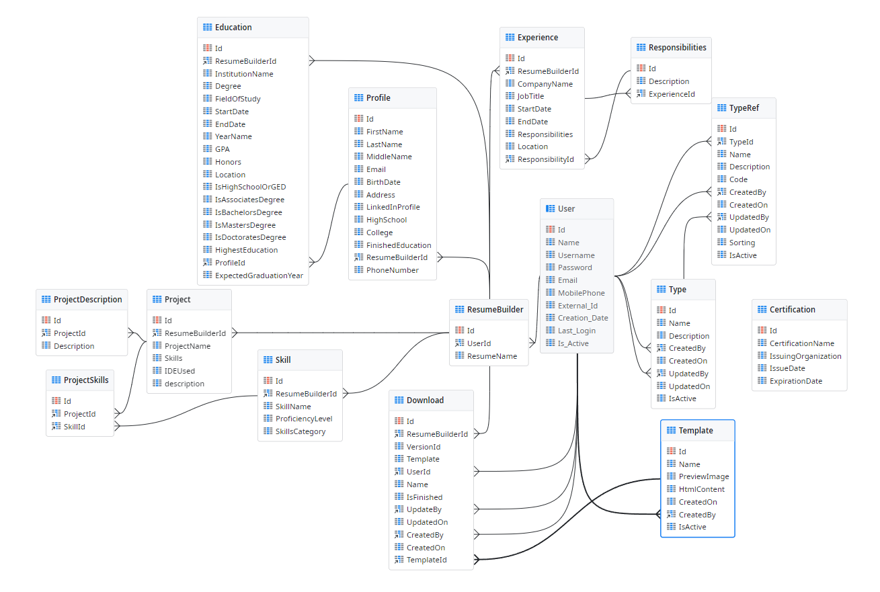
Database Infrastructure
Good database management and infrastructure is extremely important for us for better Organization and overall workflow throughout our app
Notes:
The logical database implementation of our resume builder app ensures secure storage and efficient retrieval of the user's information (Resume Inputs, Credentials, etc.).
The database is structured with multiple tables, each serving a critical function.
Key tables include Resume Builder Inputs, which store essential user details like education level, past experiences and job type, among others.
Additionally, a User Authentication table is included to manage login credentials securely, ensuring users can access their information safely.

Slide 19
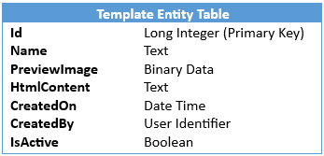
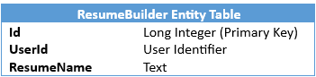
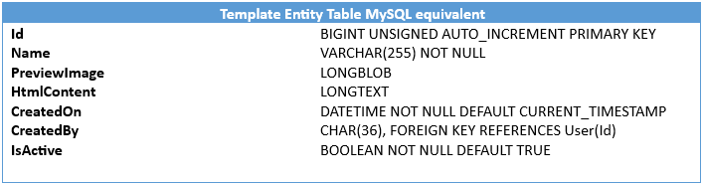
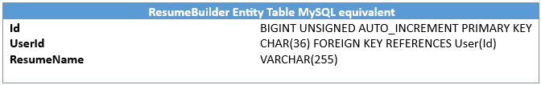
Database Schema Entities & Attributes
Template ENTITY Table
ResumeBuilder Entity table
Notes:
The database schema supports multiple entities with clearly defined attributes.
For instance, the File Cloud Storage Entity manages uploaded resume files, tracking file names, types, paths, and modification timestamps.
Furthermore, the Template Management Table enables users to select, customize, and preview resume formats, ensuring a flexible and personalized experience. The structured approach ensures that all aspects of resume creation and storage are efficiently managed while maintaining data integrity and security.
This app is designed to be frequently used by individuals looking to create or update resumes quickly and efficiently. Users may engage with the platform intensively over a short period while perfecting their resumes or return periodically to make updates. The database architecture supports this behavior by providing seamless access to saved resumes, templates, and job applications, making it an essential tool for job seekers across different career stages.

Slide 20
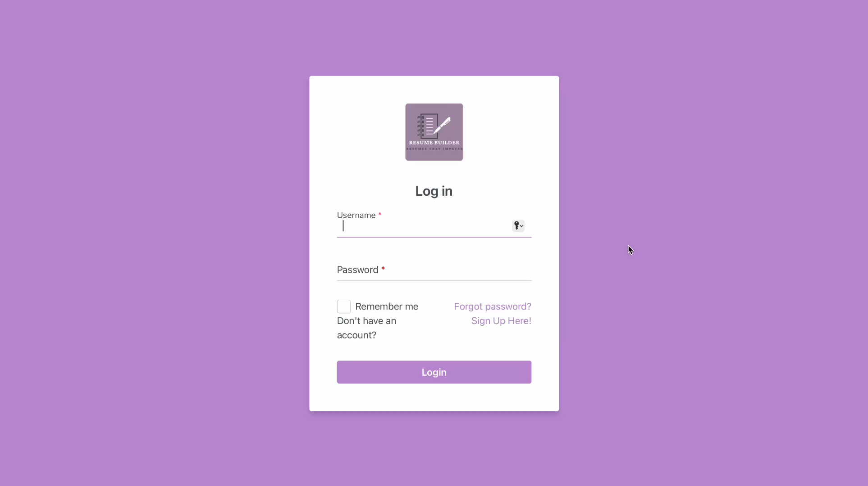
Product Demo

Slide 21

Questions?

Slide 22

References
[1] Brothwell, Pat. “Applicant Tracking Systems Aren’t Excluding Job Applicants—People Are.” Hiringthing.com, HiringThing, Inc., https://blog.hiringthing.com/applicant-tracking-system-myths. Accessed 29 Jan. 2025.
[2] Unknown author. “Why All Businesses Can Benefit from Applicant Tracking Systems.” Hiringthing.com, HiringThing, Inc., https://blog.hiringthing.com/all-businesses-benefit-from-ats-use. Accessed 29 Jan. 2025.
[3] Outsystems. “7 Myths about Low-Code—Debunked.” Outsystems.com, Outsystems, 2024, www.outsystems.com/1/low-code-myths/. Accessed 29 Jan. 2025.
[4] Unknown author. “Comparison: Why OutSystems vs. Low-Code Alternatives.” Outsystems.com, Outsystems, 2024, www.outsystems.com/1/outsystems-vs-alternatives/. Accessed 29 Jan. 2025.
[5] Unknown author. “Low-Code Doesn’t Mean Low-Control.” Outsystems.com, Outsystems, 2024, www.outsystems.com/1/low-code-faqs/. Accessed 29 Jan. 2025.
[6] Unknown author. “Low-Code for pro Developers: Enhance Your Coding Skills.” Outsystems.com, Outsystems, 2024, www.outsystems.com/1/app-development-guide/. Accessed 29 Jan. 2025.

Slide 23
References
[7] Andrei Kurtuy. (2023, May 16). 99+ Must-Know Resume Statistics To Get You Hired in 2025. Novorésumé; Novorésumé ApS. https://novoresume.com/career-blog/resume-statistics
[8] ‌Zigic, Drazen. “Closeup of a Member of Human Resource Teal Reading Candidate’s CV during the Meeting in the Office.” Freepik.com, Freepik, 2025, www.freepik.com/free-photo/closeup-member-human-resource-teal-reading-candidate-s-cv-meeting-office_26390643.htm#fromView=keyword&page=1&position=8&uuid=d1fde296-9ac8-4d51-a059-9a471a9e7457&query=People+Resume. Accessed 28 Jan. 2025.
[9] Freepik. “Free Vector | Choice of Worker Concept.” Freepik.com, Freepik, 2020, www.freepik.com/free-vector/choice-worker-concept_9544570.htm#fromView=keyword&page=1&position=4&uuid=d1fde296-9ac8-4d51-a059-9a471a9e7457&query=People+Resume. Accessed 28 Jan. 2025.

